Slide 1
Architectural Patterns

Slide 2
Introduction
An architectural pattern is a general, reusable solution to a commonly occurring problem in software architecture within a given context. Architectural patterns are similar to software design pattern but have a broader scope.

Slide 3
Architectural Patterns
Layered Pattern
Client-Server Pattern
Pipe Filter Pattern
Event-Bus Pattern
Microservices Pattern

Slide 4
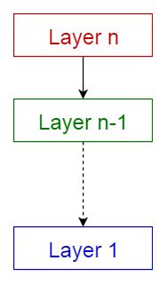
Layered Pattern
This pattern is also known as n-tier architecture pattern. It can be used to structure programs that can be decomposed into groups of subtasks, each of which is at a particular level of abstraction. Each layer provides services to the next higher layer.

Slide 5
Layered Pattern
The most commonly found 4 layers of a general information system are as follows.
Presentation layer (also known as UI layer)
Application layer (also known as service layer)
Business logic layer (also known as domain layer)
Data access layer (also known as persistence layer)
Notes:
Usage
General desktop applications.
E commerce web applications.

Slide 6
Client-server pattern
This pattern consists of two parties:
a server
multiple clients.
The server component will provide services to multiple client components.
Clients request services from the server and the server provides relevant services to those clients. Furthermore, the server continues to listen to client requests.

Slide 7
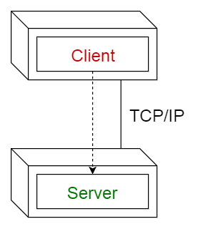
Client-server pattern
Usage
Online applications such as email, document sharing and banking.

Slide 8
Pipe-filter Pattern
This pattern can be used to structure systems which produce and process a stream of data.
Each processing step is enclosed within a filter component. Data to be processed is passed through pipes.
These pipes can be used for buffering or for synchronization purposes.

Slide 9
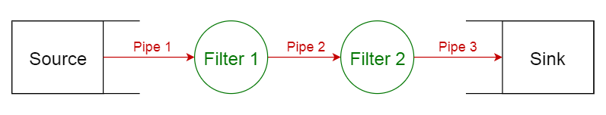
Pipe-filter Pattern
Usage
Compilers. The consecutive filters perform lexical analysis, parsing, semantic analysis, and code generation.
Workflows in bioinformatics.
Extract Transform Load (ETL)

Slide 10
Event-Bus Pattern
This pattern primarily deals with events and has 4 major components:
event source,
event listener,
channel
event bus.
Sources publish messages to particular channels on an event bus. Listeners subscribe to particular channels. Listeners are notified of messages that are published to a channel to which they have subscribed before.

Slide 11
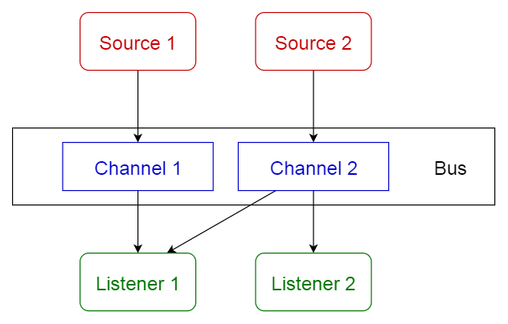
Event-Bus Pattern
Usage
Android development
Notification services

Slide 12
Microservices Pattern
Microservices - also known as the microservice architecture - is an architectural style that structures an application as a collection of loosely coupled services, which implement business capabilities.
The microservice architecture enables the continuous delivery/deployment of large, complex applications.
It also enables an organization to evolve its technology stack.

Slide 13
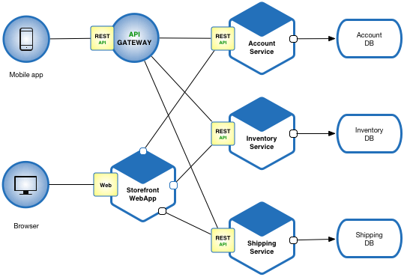
Microservices Pattern
Let’s imagine that you are building an e-commerce application that takes orders from customers, verifies inventory and available credit, and ships them. The application consists of several components including the StoreFrontUI, which implements the user interface, along with some backend services for checking credit, maintaining inventory and shipping orders. The application consists of a set of services.

Slide 14
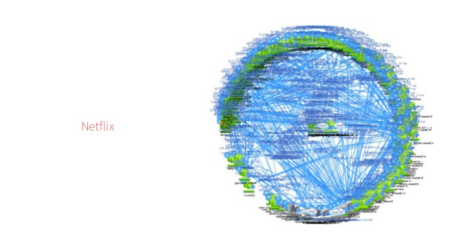
MicroServices on Netflix
The Netflix Death Star

Slide 15
Bibliography
https://medium.com/towards-data-science/10-common-software-architectural-patterns-in-a-nutshell-a0b47a1e9013
http://microservices.io/patterns/microservices.html

